Slide 1

VIJAYA VITTALA INSTITUTE OF TECHNOLOGY
DEPARTMENT OF COMPUTER SCIENCE AND ENGINEERING
Technical Seminar
On
Eco-Fertilisation
Submitted By
MOHAMMED JABIR
[1VJ19CS034]
Internal Guide
Prof. Naveen G B.E., M.Tech, Phd

Slide 2
CONTENTS
Introduction
Literature Review
Objectives Methodology
Implementation Model
Implementation Algorithm
References

Slide 3
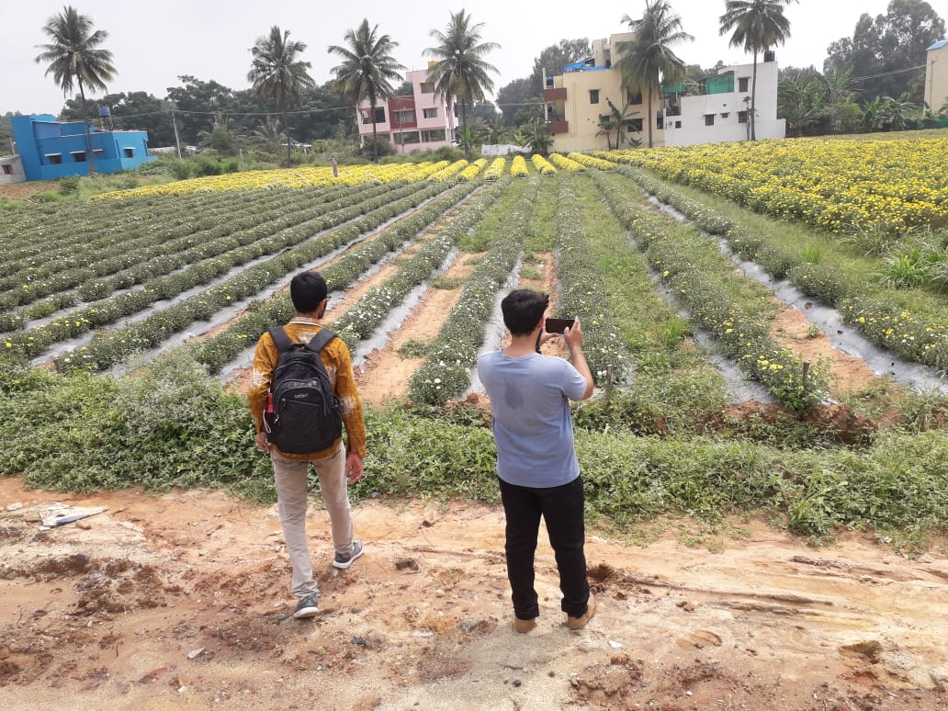
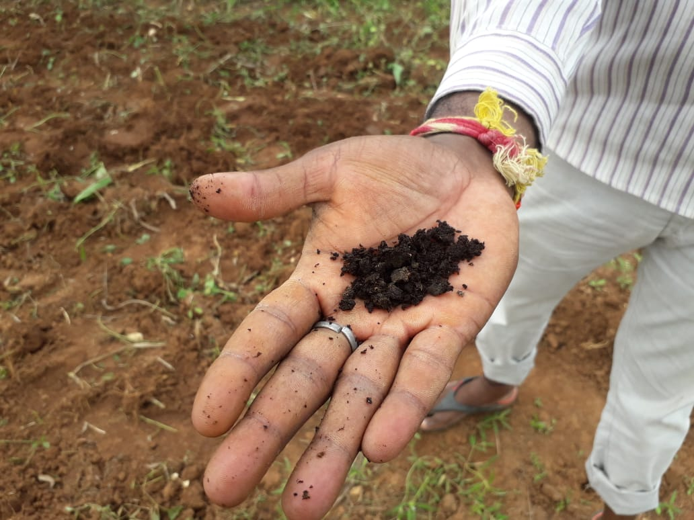
INTRODUCTION
Fertilizers, under farmer control, need proper guidance for achieving the best yields and reducing losses.
Rainfall also affects fertilizer retention, too much leads to run-off, and too less leads to the soil not absorbing the nutrients like nitrogen (N), phosphorous (P), potassium (K), manganese (Mn), and boron (B).
This project presents nutrient recommendations using an updated iteration of the random forest algorithm based on time-series data to inform the required quantity of nutrients for various crops by examining rainfall patterns and crop fertility.
The method suggested in this project improves soil fertility by providing nutrient recommendations for optimum conditions by reducing leaching and run-off potential.

Slide 4
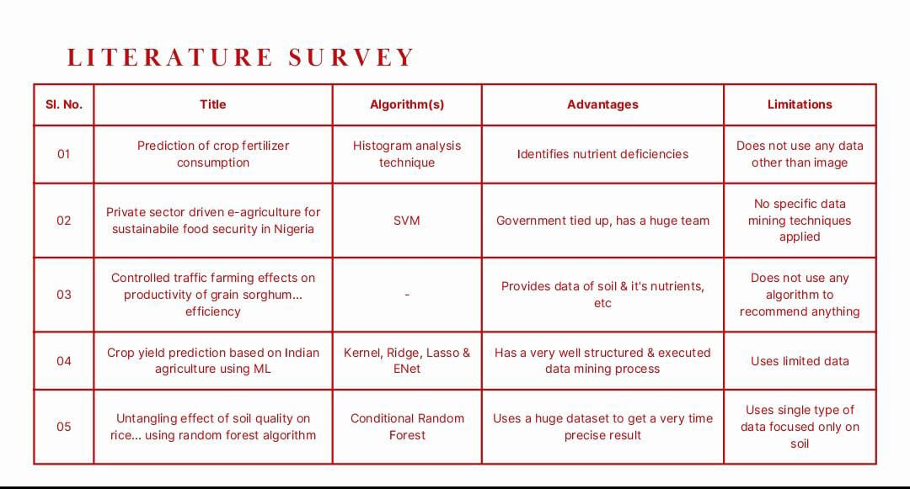

Slide 5

Objectives
To provide useful information for fertilizer use in terms of nutrients (NPK) by considering weather forecasts.
To reduce water pollution by slowing down the process of leaching.

Slide 6
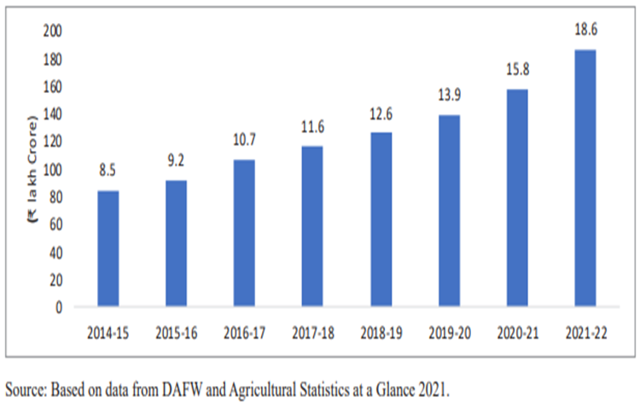
Growth in agricultural Sector
India’s agriculture sector witnessing robust growth with average annual growth rate of 4.6 per cent over last six years

Slide 7
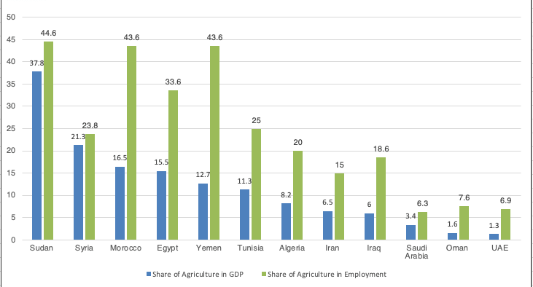
Share of Agriculture In GDP and Employment

Slide 8
Problem Statement
Existing System
This system uses two data mining techniques to provide recommendations.
Recommendations of suitable crop in the field and fertilizers for crops to farmers are provided with the help of data stored in ontology.
Existing system provides crop recommendation based on NPK content of soil, available in soil to their mobile phones.
Drawbacks of Existing System
Low efficiency’
Doesn’t use weather data.
Low accuracy
Regional application

Slide 9
PROPOSED SYSTEM
In this system, a predictive model for the nutrients required for crops will be obtained using random forest algorithms.
A total of seven features have been used to evaluate the algorithm. The algorithm requires input from the user (such as location and crop).
The location is fed to the Weather API which will return certain characteristics (eg: temperature, humidity, rainfall) and if there is a possibility of heavy rainfall, a precautionary message is displayed to the user, otherwise, the proposed algorithm is followed.
Objectives of Proposed System
Higher efficiency through two algorithms (Random Forest & K-cross validation).
Fetches weather data from from weather API
Higher accuracy ,Wider Application
Uses old and new data.

Slide 10
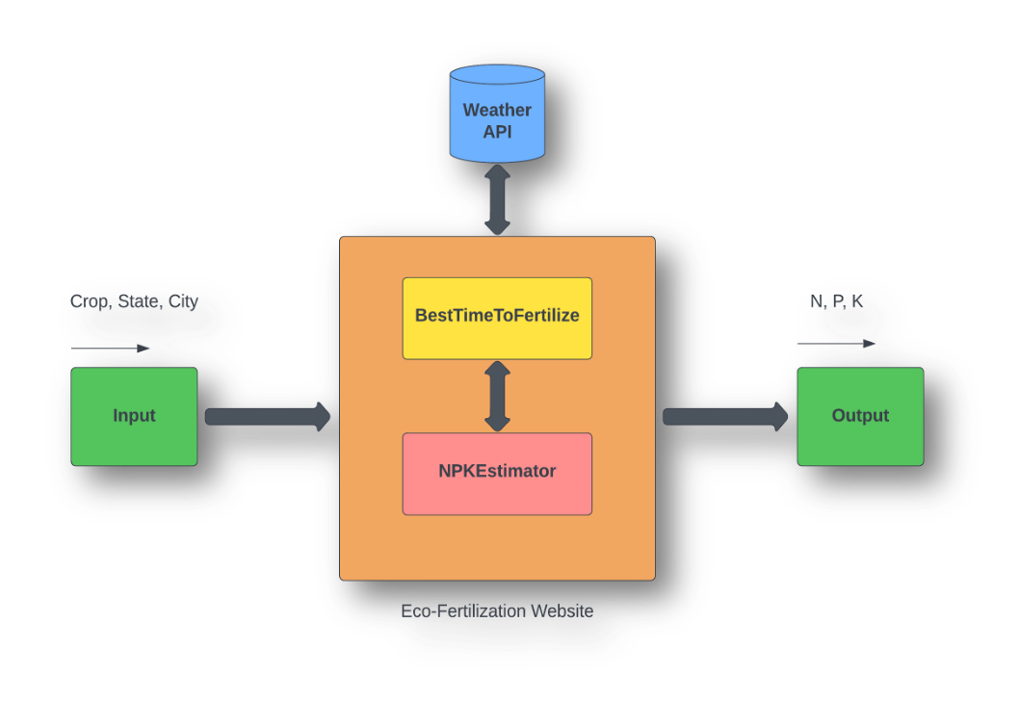
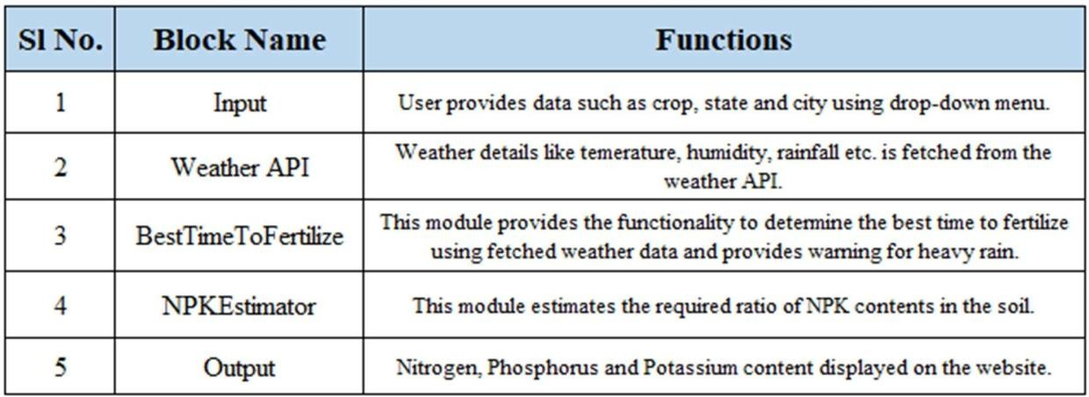
Implementation Module
Block Diagram
System architecture is a conceptual model that defines the structure and behavior of the system. It comprises of the system components and the relationships describing how they work together to implement the overall system. The Figure shows the system’s architecture and the various components added to them.
The description of each component from the block diagram and their major functionalities with respect to the Eco-Fertilization as a complete unit is described in the table below.

Slide 11
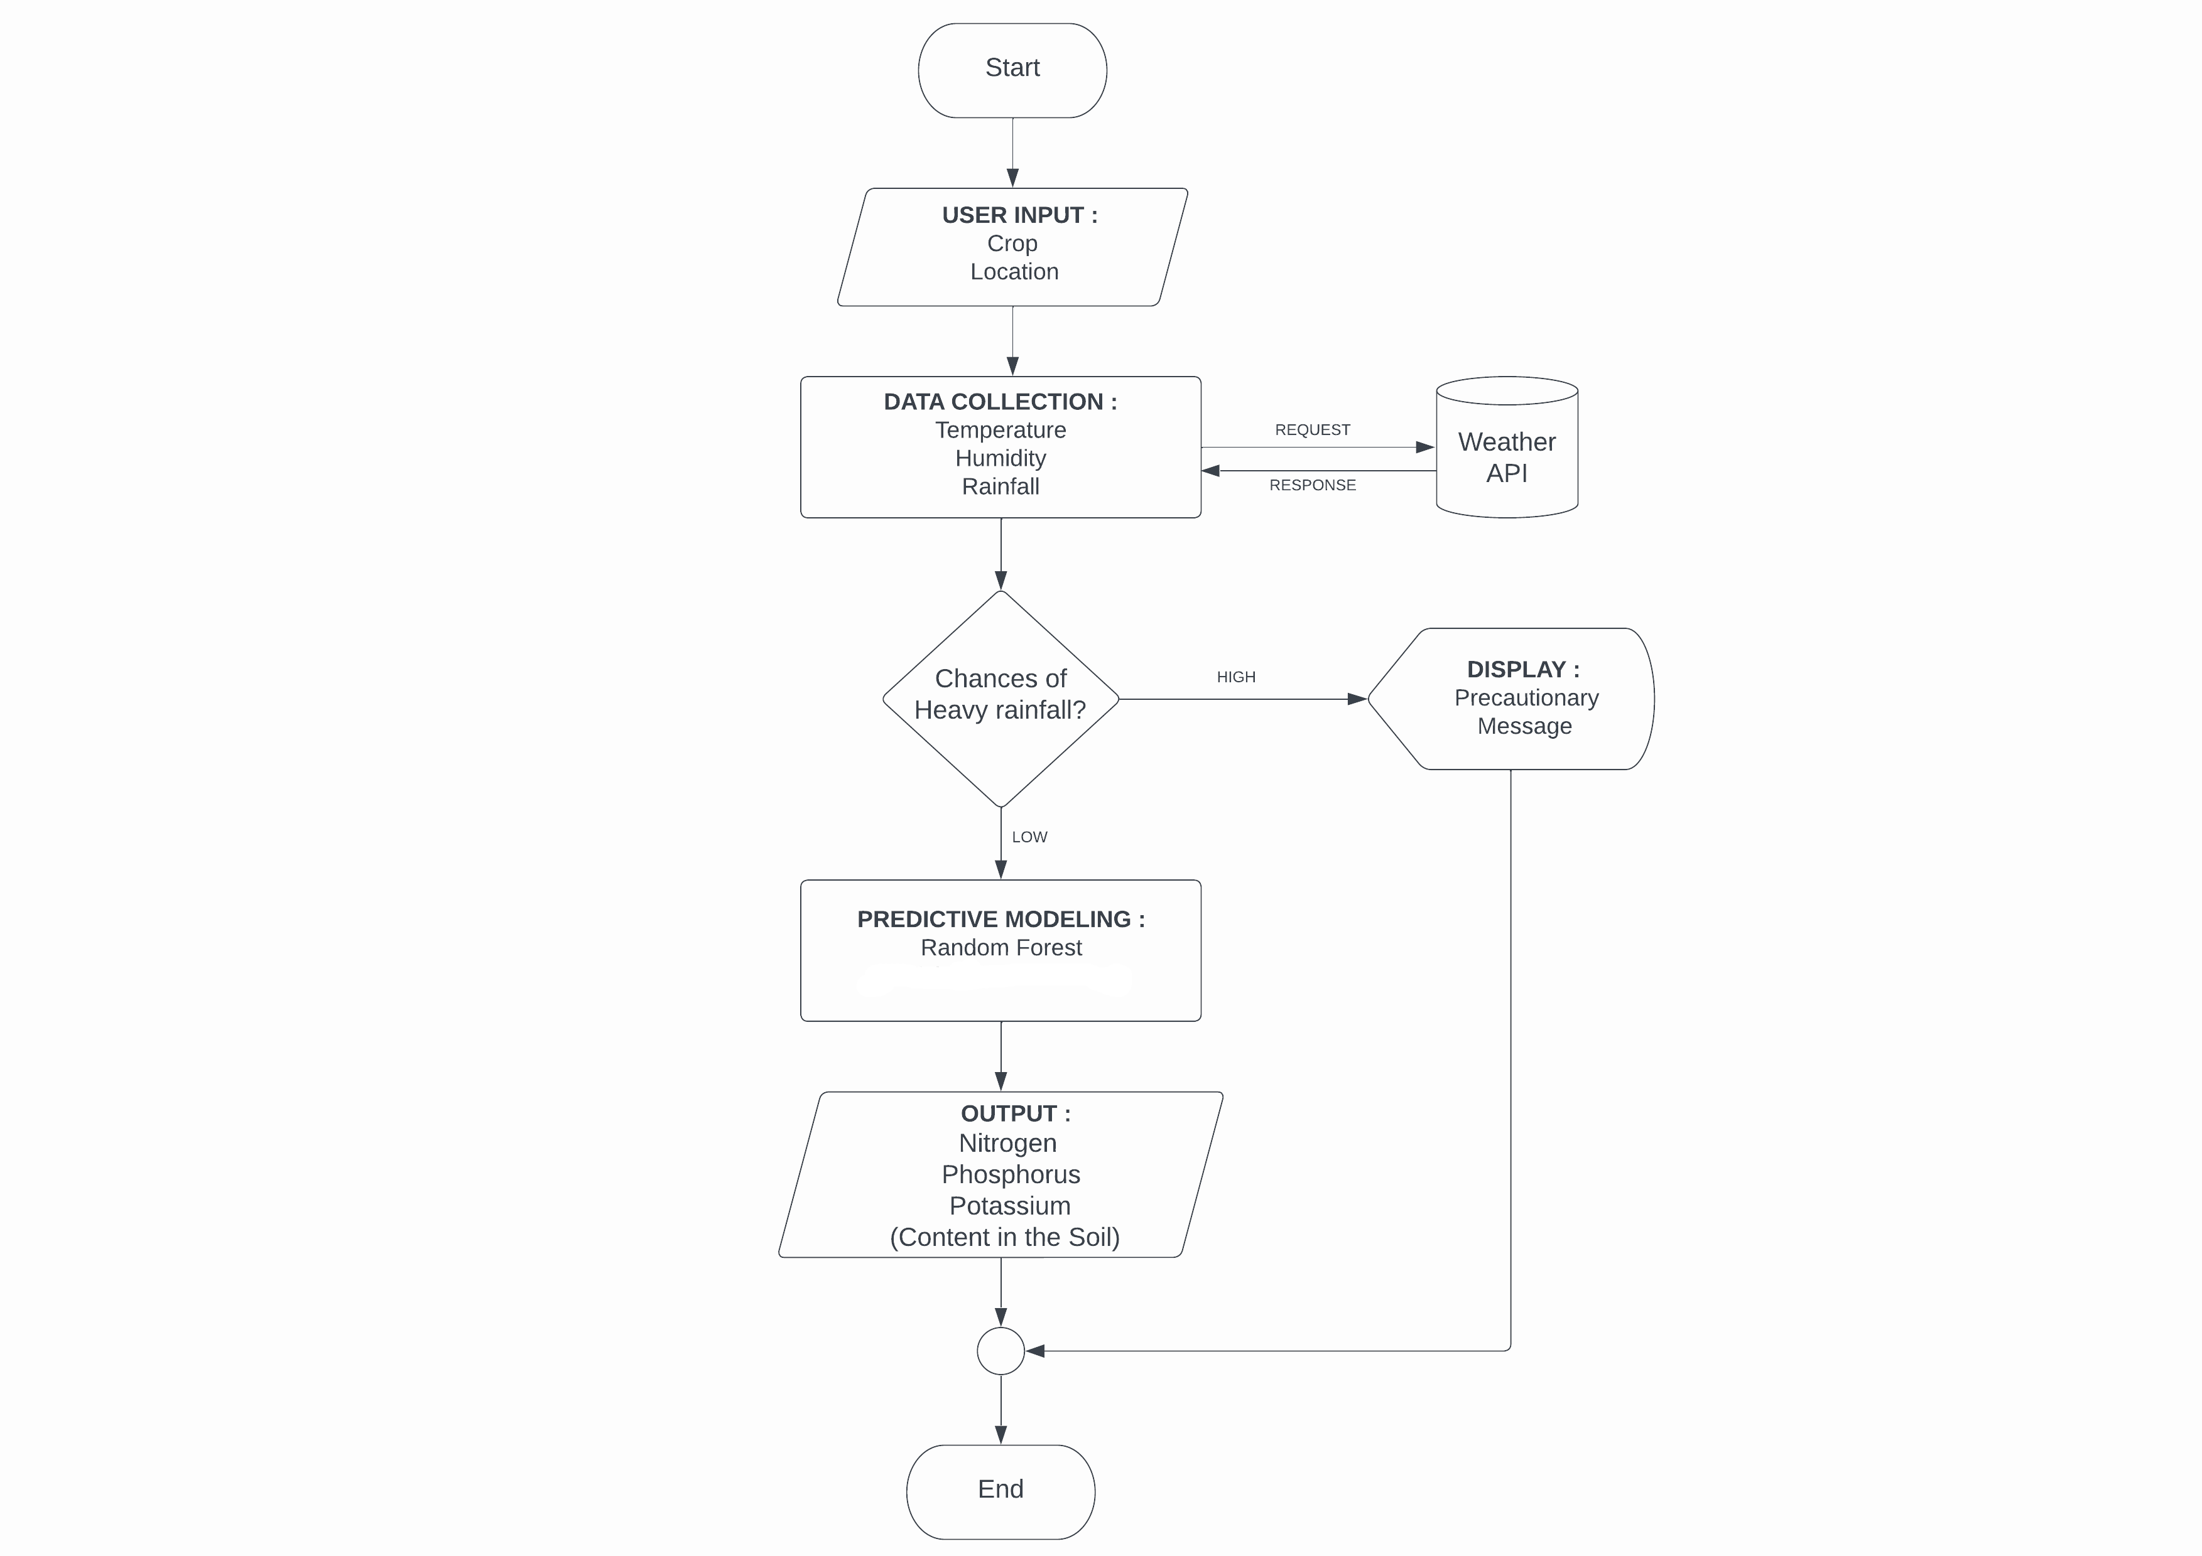
Implementation Module
Flow Chart

Slide 12
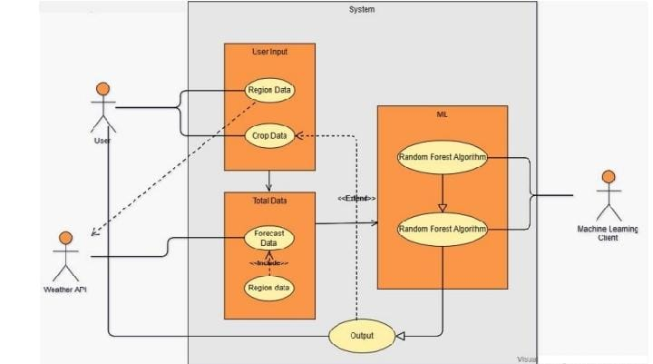
Implementation Module
Use Case Diagram

Slide 13
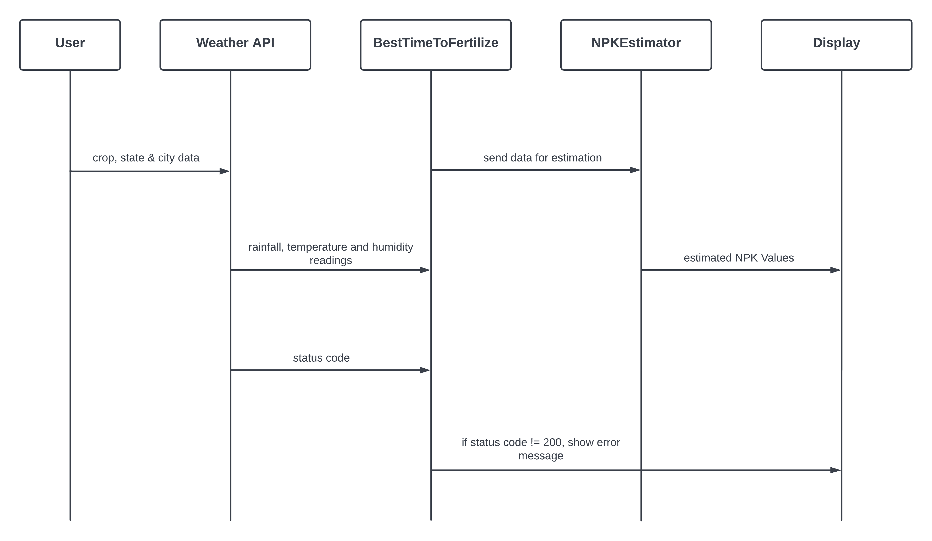
Implementation Module
A sequence diagram shows object interactions arranged in time sequence.
It depicts the objects and classes involved in the scenario and the sequence of messages exchanged between the objects needed to carry out the functionality of the scenario.
Sequence diagrams are typically associated with use case realizations in the Logical View of the system under development.
Sequence diagrams are sometimes called event diagrams or event scenarios.
A sequence diagram consists of parallel vertical lines (lifelines) which shows different processes or objects that live simultaneously, and horizontal arrows that depicts the messages exchanged between them, in the order in which they occur.
This allows the specification of simple runtime scenarios in a graphical manner.
Sequence Diagram :

Slide 14
Data Description
Input Features :
Crop : rice, cotton, etc.
Temperature : temperature in degree Celsius
Humidity : relative humidity in percentage
Rainfall : rainfall in mm
Output Features :
Label_N : ratio of Nitrogen content in soil
Label_P : ratio of Phosphorous content in soil
Label_K : ratio of Potassium content in soil

Slide 15
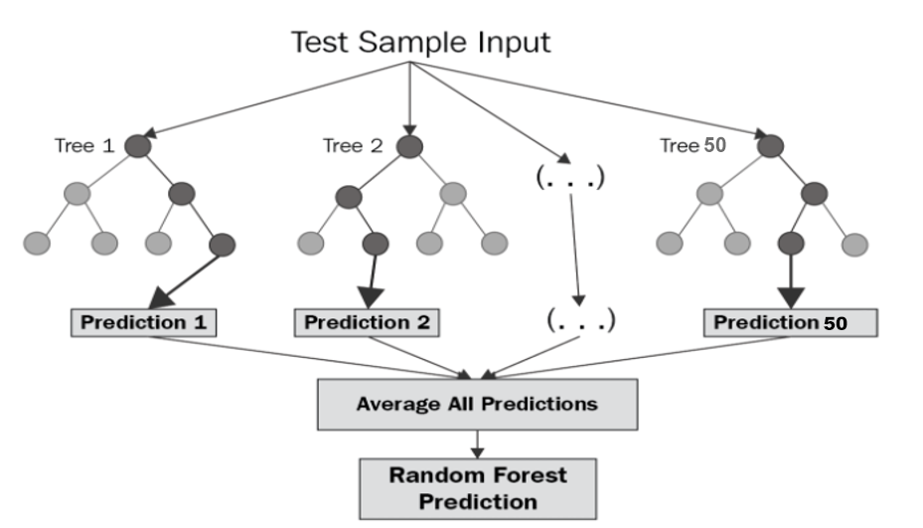
Implementation Algorithm
Random forest (RF) is a collection of multiple decision trees that have variable hyper-parameters and are trained using varying subsets of data.
In our project,we are going to take crop and location as input, and based on it, we will predict the value of N, P, and K.
First, we will divide our dataset into training and test datasets, where the training dataset is 80% of the original data and the rest 20% is test data.
Then we will create three different random forests of size 50 (decision tree) for each N, P, and K and outputs the mean of the classes as the prediction of all the trees, shown in Table

Slide 16
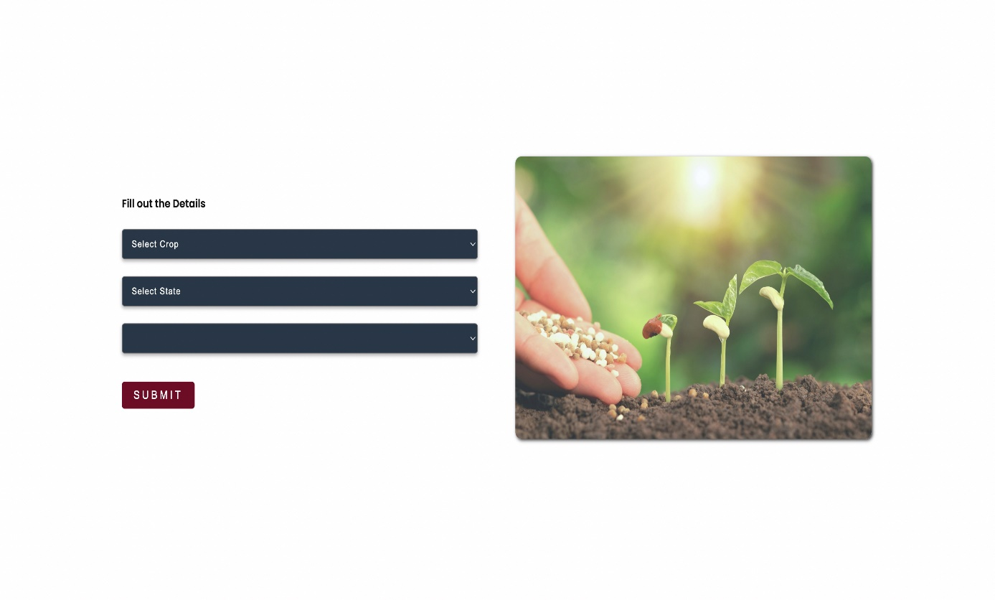
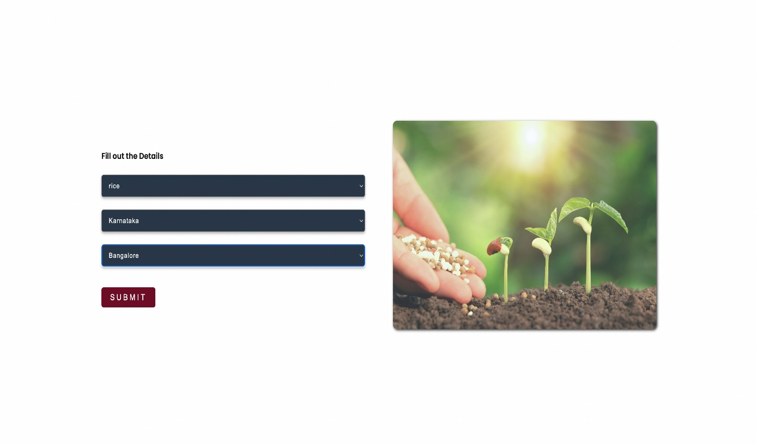
Results

Slide 17
THANK YOU

